Slide 1
Physics in Communication and Multimedia

Slide 2
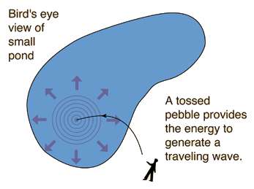
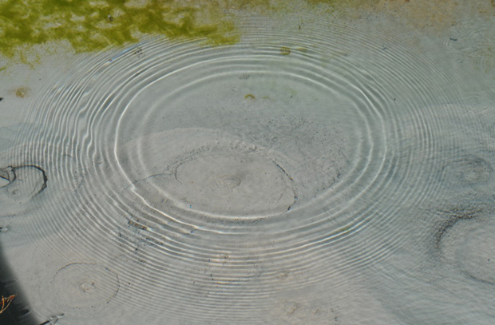
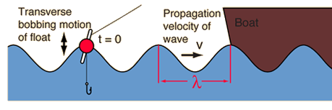
Mechanical Waves
Cause by a disturbance in a medium

Slide 3
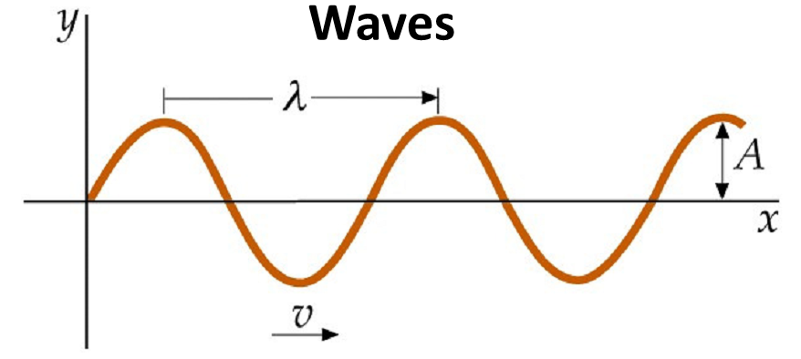
Mechanical Waves
Wavelength (λ) - distance between two crest (highest values)
Amplitude (A) – maximum height

Slide 4
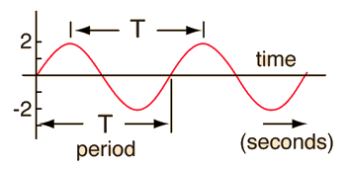
Mechanical Waves
Period (T) – time of a complete cycle
Frequency (f) – number of cycle per unit time

Slide 5
Mechanical Waves
Wave velocity (v) – measure of the fastest of the wave propagation

Slide 6
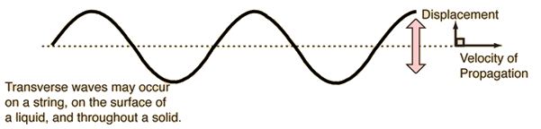
Transverse wave
displacement of the medium is perpendicular to the direction of propagation of the wave (e.g., wave in the pond, waves on a string)

Slide 7
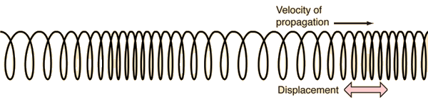
Longitudinal Waves
Displacement of the medium is parallel to the propagation of the wave (e.g., sound waves in air)

Slide 8
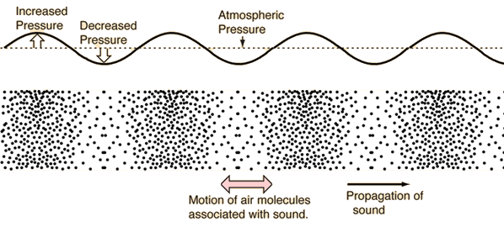
Sound waves
mechanical wave that is an oscillation of pressure (or air density) transmitted through a solid, liquid, or gas
The air motion → back and forth in the direction of the propagation of the sound

Slide 9
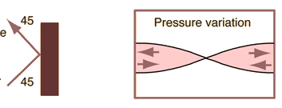
Reflection
Bouncing of waves when they hit a surface

Slide 10
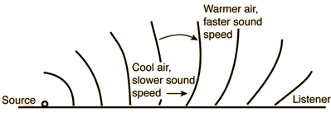
Refraction
bending of waves when they enter a medium where their speed is different

Slide 11
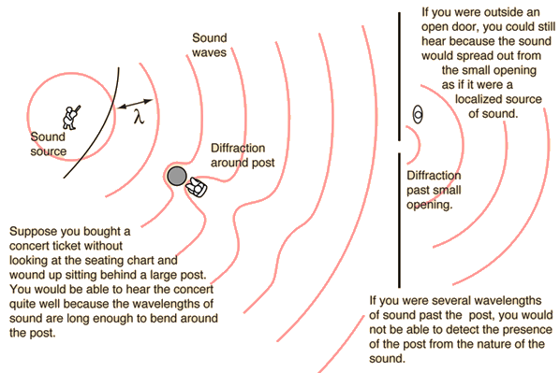
Diffraction
the bending of waves around small obstacles and the spreading out of waves beyond small openings

Slide 12
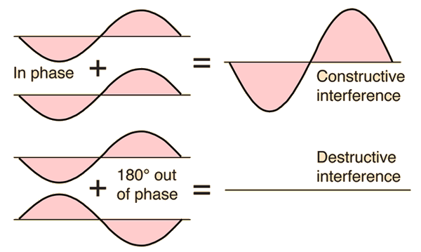
Interference
superposition of waves

Slide 13
Electromagnetic (EM) waves

Slide 14
Maxwell Equations

Slide 15
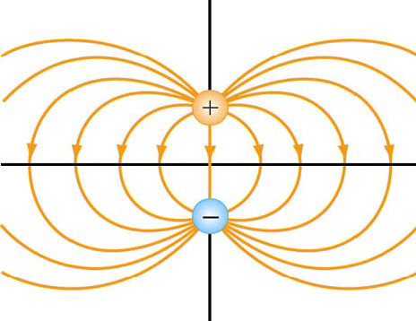
1) Gauss’s Law for Electric Field
Electric field is produced by charges

Slide 16
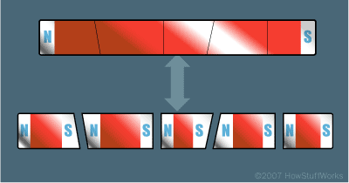
2) Gauss’s Law for Magnetic field
Magnetic monopole do not exist

Slide 17
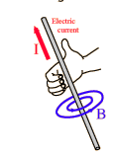
3) Ampere-Maxwell Law
Magnetic field is produced by
Current
Changing electric field

Slide 18
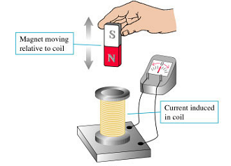
4) Faraday’s Law
Electric field can be produced by changing magnetic field

Slide 19
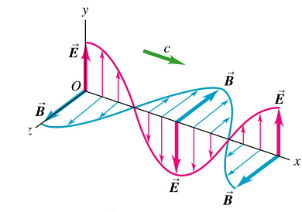
Ampere’s law
Faraday’s law
Oscillating current
(Changing current)
Changing Magnetic field (B)
Changing Electric field (E)
Ampere’s law
Changing Electric field (E)
Changing Magnetic field (B)
Continue…
Faraday’s law

Slide 20
Electromagnetic (EM) Waves

Slide 21
Properties of Electromagnetic Waves
EM wave equation was derived from the Maxwell's equation.
The electric field (E-field) and the magnetic field (B-field) are the “waves”

Slide 22
Properties of Electromagnetic Waves
The wave is transverse.
The E-field, B-field & direction of propagation of the wave , v, are mutually perpendicular

Slide 23
Properties of Electromagnetic Waves
There is a definite ratio between the E-field and B-field
c = speed of light in vacuum
ε_{o} = Permittivity of free space (E-field)
μ_{o} = permeability of free space (B-field)

Slide 24
Properties of Electromagnetic Waves
The EM waves require no medium.
The EM wave travels in vacuum with a definite and unchanging speed.

Slide 25
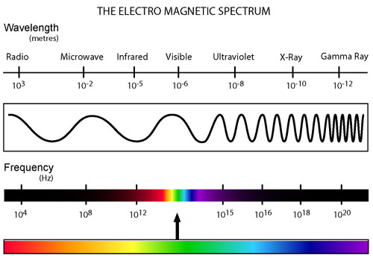
Electromagnetic Waves
c = speed of light (2.998 x 10⁸ m/s)
λ = wavelength
f = frequency

Slide 26
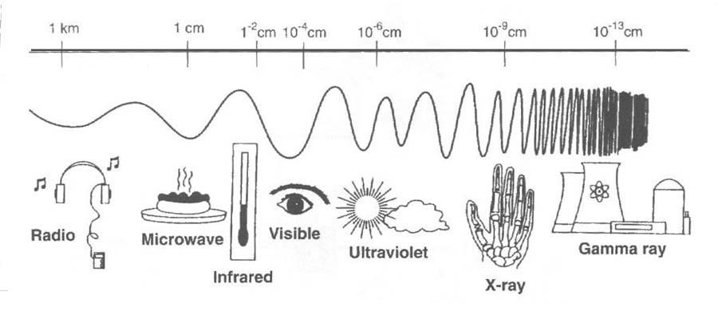
Energy (E) of Electromagnetic Waves
h = Plank’s constant (6.626 x 10⁻³⁴ J-s)

Slide 27
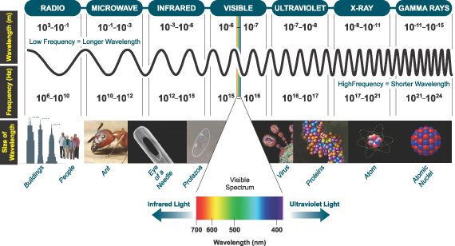
Electromagnetic Spectrum

Slide 28
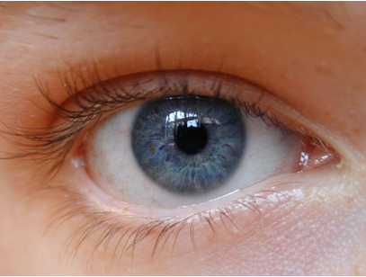
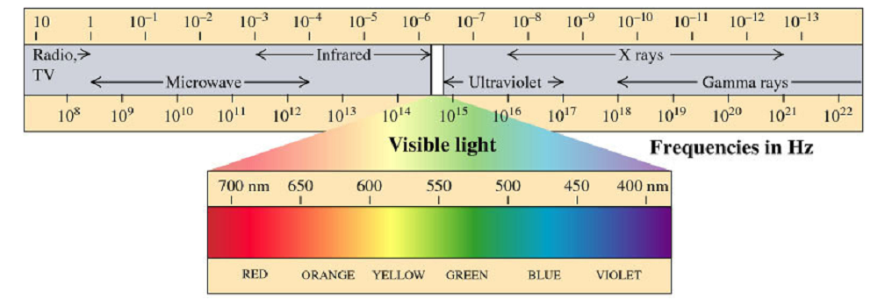
Light
Portion of EM spectrum in which human eye is sensitive

Slide 29
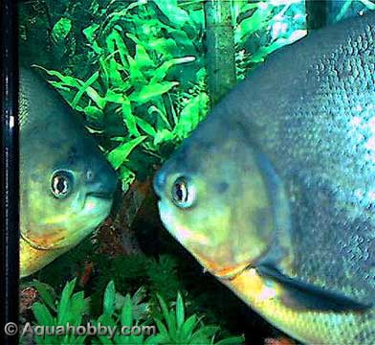
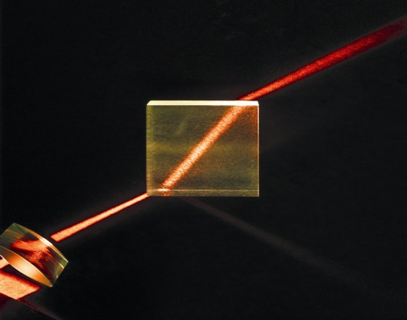
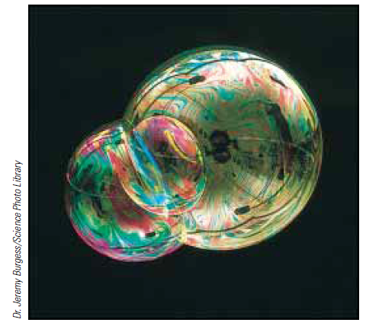
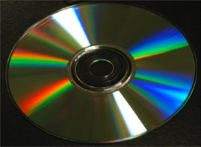
Properties of Light
Reflection
Refraction
Diffraction
Interference

Slide 30
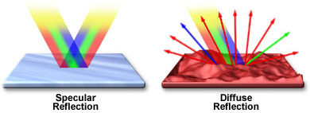
Reflection
Bouncing of light when they hit a surface

Slide 31
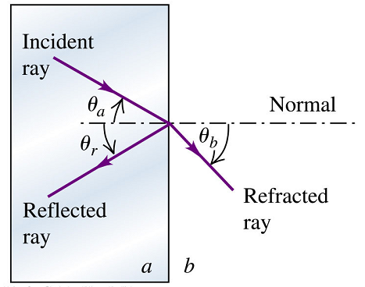
Law of Reflection
angle of incident = angle of reflection
(angle → with respect to normal)

Slide 32
Specular vs Diffused Reflection
Specular Reflection
Reflection from a smooth surface
Diffuse Reflection
Reflection from a rough surface

Slide 33
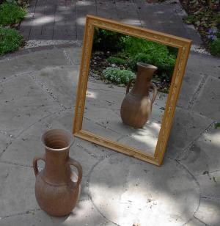
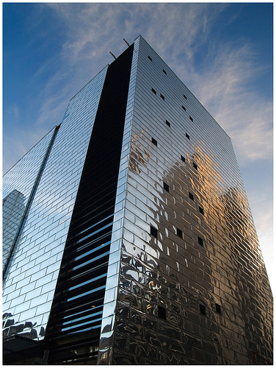
Specular vs Diffused Reflection
http://content.answers.com/main/content/wp/en/6/6a/Mirror.jpeg
http://farm2.static.flickr.com/1345/1439949678_52a94732b1.jpg?v=0

Slide 34
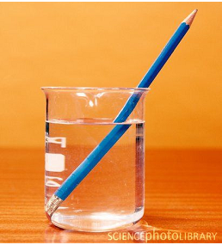
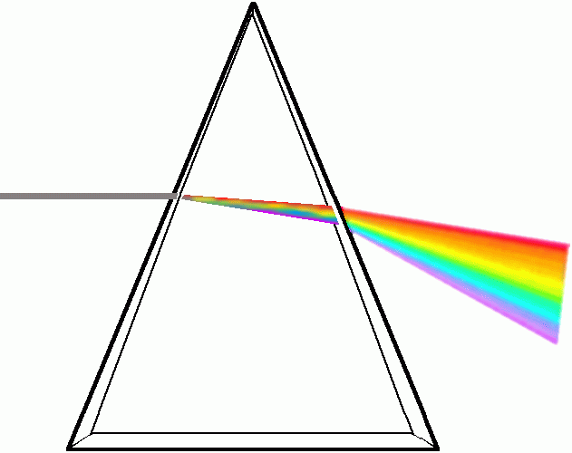
Refraction
bending of light when they enter a medium where their speed is different

Slide 35
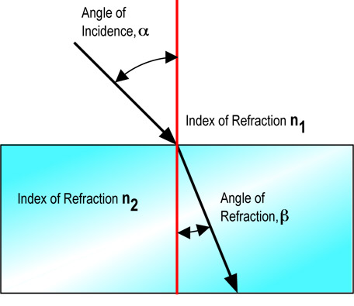
Law of Refraction (Snell’s Law)
θ₁
θ₁=angle of incidence
θ₂
θ₂=refracted angle
Index of refraction (n) = ratio of the speed of light in vacuum (c) with the speed of light in a material (v)

Slide 36
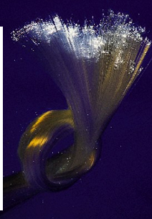
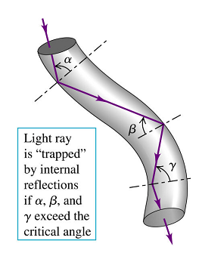
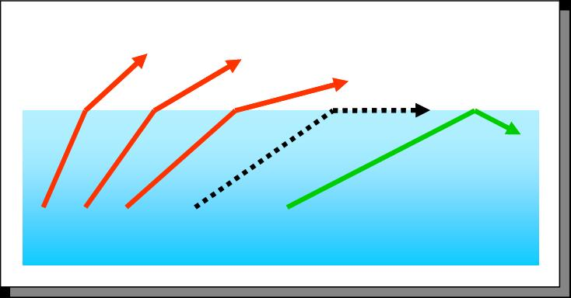
Total Internal Reflection
No refraction, purely reflection
Total internal reflection
Fiber optics

Slide 37
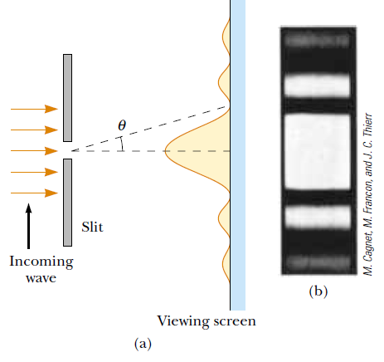

Diffraction
the bending of light around small obstacles and the spreading out of light beyond small openings

Slide 38
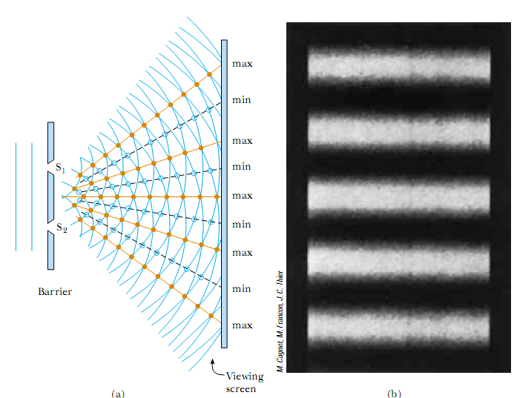
Interference
superposition of waves

Slide 39




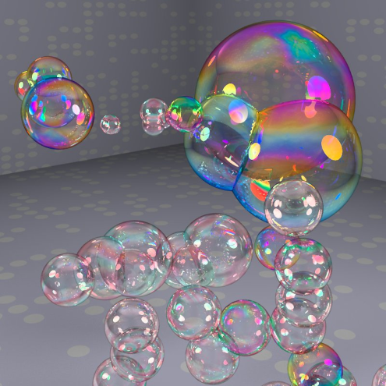
Interference

Slide 40
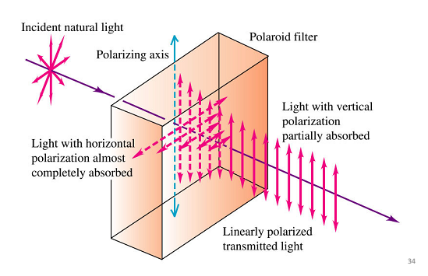

Polarization
The process by which light is limited to vibrate in particular direction
Natural light → not polarize (E-field → all direction)
For simplicity→ shows E-field only

Slide 41
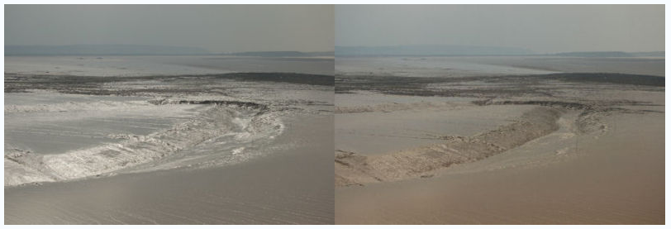
Polarization
No polarizer
With Polarizer

Slide 42
Optical image

Slide 43
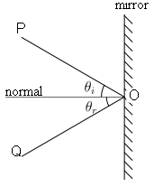
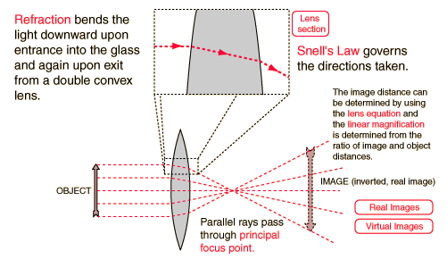
Mirror vs Lens
Mirror
(reflecting surface)
Lenses
(refracting surface)

Slide 44
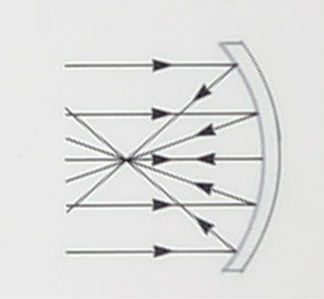
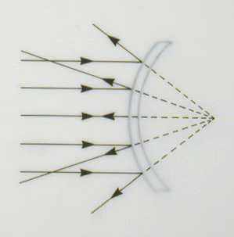
Mirrors
http://www.dkimages.com/discover/previews/862/45031168.JPG
http://www.dkimages.com/discover/previews/862/45031175.JPG
concave
convex

Slide 45
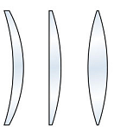
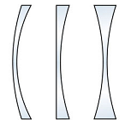
Lenses
Converging / positive lens
(thicker in the middle)
Diverging/ negative lens
(thinner in the middle)

Slide 46
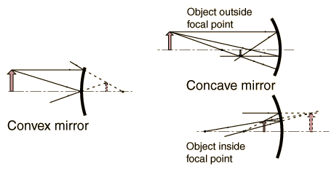
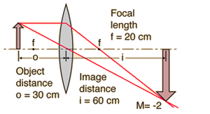
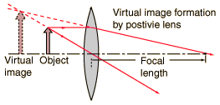
Real vs. virtual image
Note the difference between mirrors and lenses
mirror
mirror
lens
lens
Virtual image – light does not actually emanate from the image point
Real image – light does emanate from the image point

Slide 47
Upright/erect vs. Inverted Images
Upright/erect image
Inverted image

Slide 48

Convex Mirror
Virtual
Upright
Smaller magnification
www.moby.com

Slide 49

Concave Mirror
“Far” object
real
inverted
Smaller magnification
“Near” object
virtual
Upright/erect
larger magnification

Slide 50
Converging (positive) lens
Virtual
Upright/erect
Larger magnification
Real
inverted
Larger magnification

Slide 51

Diverging (negative) lens
virtual
Upright/erect
smaller magnification

Slide 52

Photoelectric Effect (Light as Particle)
Ejection of electrons from a material’s surface in the presence of light (EM radiation)
Shows that light energy is quantized → exist as energy bundles (photon) → shows particle nature

Slide 53
Wave vs. Particle
Particle
travels in straight line until they collide to something, after which they will travel again in straight line
Wave
Bend around corner (diffraction)
Interfere with on another (interference)

Slide 54
Wave-Particle Duality
Everything propagates like a wave and exchange energy like a particle

Slide 55
Light: Wave-Particle Duality
Properties | Wave | Particle
Reflection
Refraction
Interference
Diffraction
Polarization
Photoelectric effect

Slide 56
de Broglie’s wavelength, λ (Matter waves)
(Classically) matter → particle
Matter, with momentum (p), → exemplified wave property. The associated wavelength (de Broglie’s wavelength, λ) is
h = Plank’ constant (6.63 x 10⁻³⁴ J-s)
m = mass
v = velocity
Note: for macroscopic particle, the wavelength is very small that it is difficult to see their wave properties (e.g., diffraction or interference)

